Slide 1
ATTENDANCE SYSTEM USING FACE RECOGNITION
BY:
AVIRAL KAPOOR
VISHNUPRIYA JAYARAMAN

Slide 2
Abstract
More than half of the students in India are now receiving education through online classes due to the ongoing circumstances.
Taking attendance has become more difficult than teaching itself. All teachers now take attendance through roll call which gives birth to 2 main issues:
1) Increase in number of proxies
2) You don't know whether the student is actually paying attention.
The method is also very time consuming and doesn’t seem feasible during exams, given the high chances of proxy and time it takes.
All such problems require a real-world solution.

Slide 3
Introduction
The Attendance System using Face Recognition, recognizes the faces through webcam with high accuracy and records live attendance, with name and time in an excel sheet.
Numerous algorithms and techniques have been developed for improving the performance of face recognition but the concept to be implemented here is Deep Learning.
Deep Learning is one among the interesting domains that enable the machine to train itself by providing some datasets as input and provides an appropriate output during testing by applying different learning algorithms.

Slide 4
Literature Review
1) Face recognition-based attendance system:
In the Face recognition-based attendance system, people have to register with their images & names, the camera installed in the room captures video of each individual & stores it in the database, frames are extracted from the video and matched with the existing images of the registered people.
2) Automatic Attendance System Using Face Recognition Technique:
In this research paper, the solution is implemented by Haar features and AdaBoost classifier.
They have created a Graphical User Interface (GUI) for storing name & roll no of students, which in turn generates a dataset and is used for training the neural network.
A camera is fitted at the door of the classroom, which captures real-time images of the students and after comparing them with the stored images, marks them present in the excel sheet along with the time of entry.

Slide 5
3) An improved face recognition algorithm and its application in the attendance management system:
The solution for identifying human faces from captured images and videos is given by a new method using Local Binary Pattern (LBP) algorithm combined with advanced image processing techniques such as Contrast Adjustment, Bilateral Filter, Histogram Equalization and Image Blending to overcome the issues hampering the accuracy of face recognition in order to improve the LBP codes, thus improve the accuracy of the overall face recognition system.
4) Biometric Attendance System using Iris Recognition:
This research paper aims to improve the reliability of attendance records by using iris recognition and detection algorithms. Since every one has a different iris pattern, which is independent of genetic factors, this method has a high accuracy.
The system uses MATLAB software. It performs a series of steps namely image acquisition, iris location, pre-processing, iris texture feature extraction and signature encoding, iris signature matching for recognition or verification to give the most accurate result.

Slide 6
5) A Design and Implementation of a Wireless Iris Recognition Attendance Management System:
This research paper proposes a wireless iris recognition attendance management system based on Daugman’s algorithm. Eye scanner, microcontroller and RF wireless communication module are main components of the system.
First everyone’s eyes digital image is taken, an algorithm of feature extraction is carried out. Minutiae are extracted and stored as a template for later verification. For marking attendance people place his eyes on the iris recognition sensor for extracting the minutiae from the captured image. The matching algorithm is applied to match the minutiae with the previously stored template to give the accurate results.

Slide 7
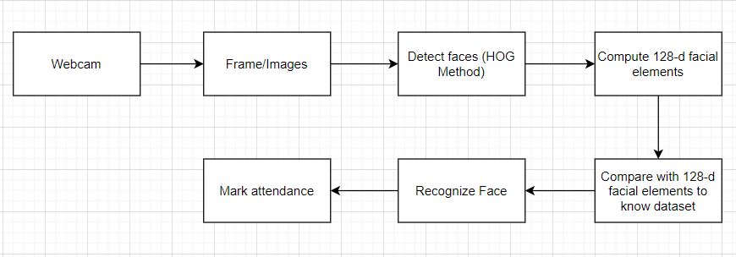
Implementation

Slide 8
Implementation
After the webcam supplies the image as an input to the neural network, it detects the face using HOG method. From the detected face 128-d facial embedded features are extracted and are compared with the stored 128-d facial element vector in the dataset.
After a match is found, attendance is marked in the excel sheet by adding an entry with name and time, otherwise not.

Slide 9
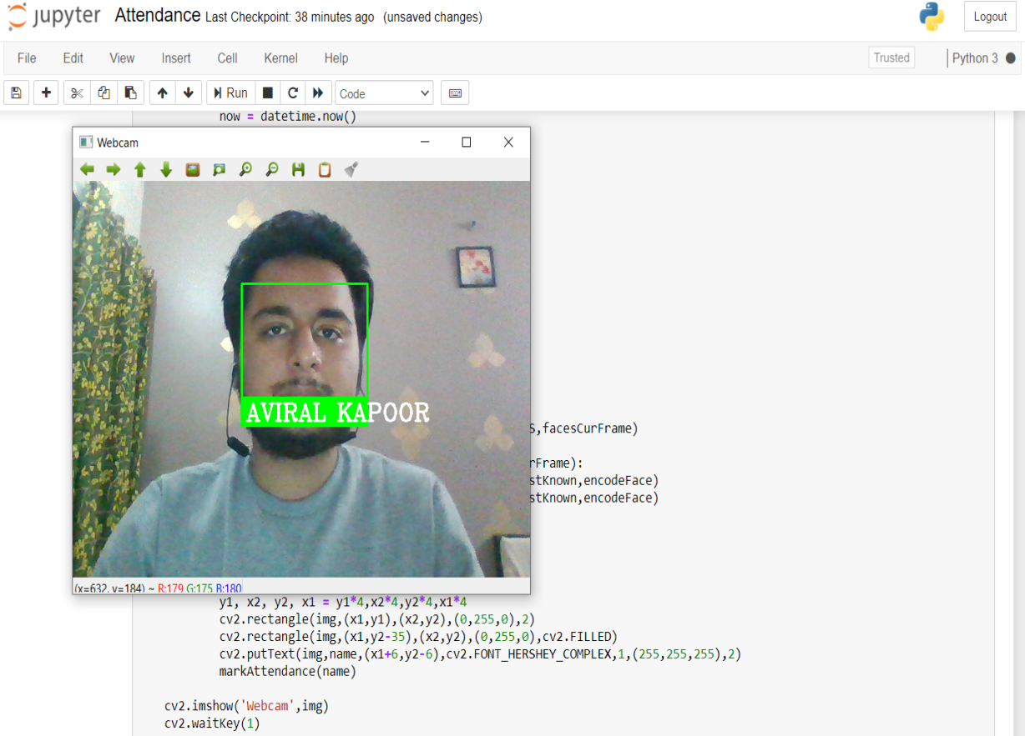
Result
Real-time image Capturing using webcam (Front profile)

Slide 10
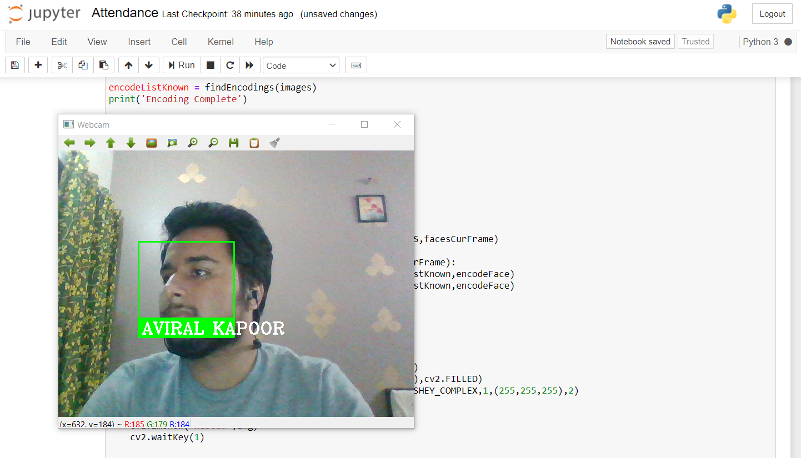
Real-time image Capturing using webcam (Side profile)

Slide 11
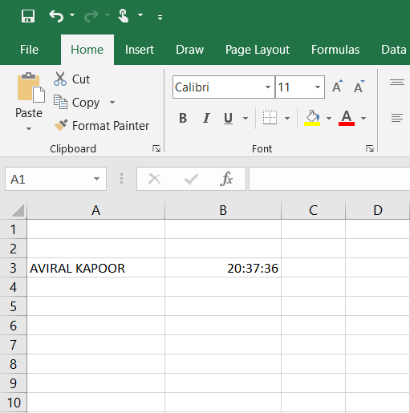
Attendance Excel Sheet

Slide 12
Conclusion
Attendance system using face recognition is designed to overcome the issues of existing manual attendance systems. We have used face recognition concept to mark the attendance of student and make the system more accurate and efficient. The system performs satisfactory in different poses and variations.
The system sometime fails to recognize from a considerable amount of distance, which can be improved in future. Also, the performance of the recognition process depends upon the processing speed of the system over which it is executed. A system of high processing speed may result even more efficient.

Slide 13
Thank you

